Slide 1
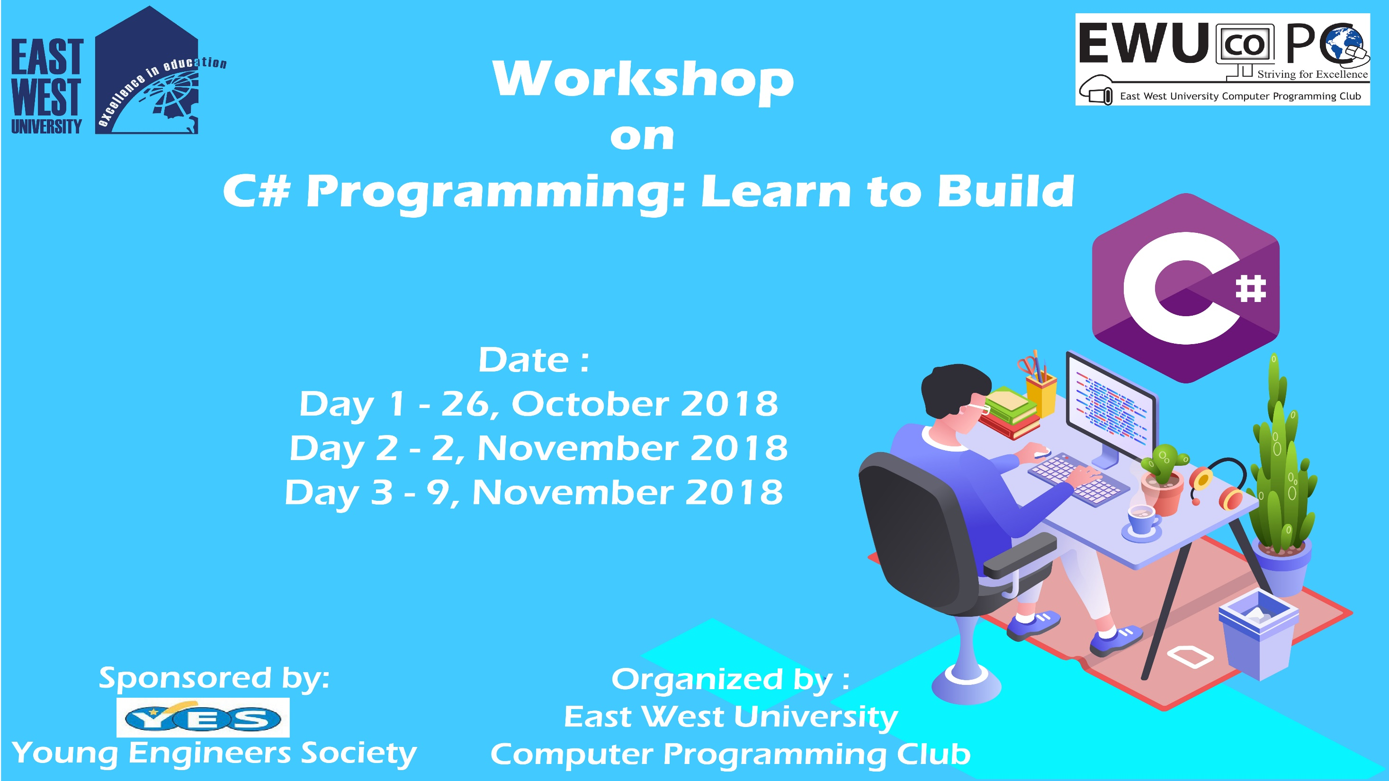

Slide 2
C# Day 2 Lecture6: Decision Making

Slide 3
Decision Making
if
if (expression)
{
statement;
}

Slide 4
Decision Making
int a = 5;
if(a>1){
Console.Writeline(“a is greater than 1”);
}
Console.Writeline(“a’s value is: {0}”, a);
Console.ReadLine();

Slide 5
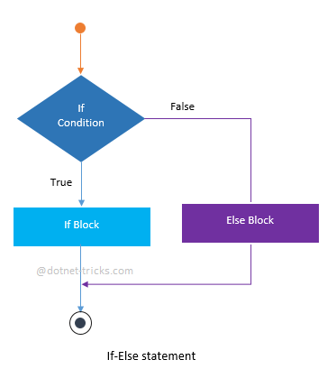
Decision Making
if…else
if (expression)
{
statement;
}
else
{
statement;
}

Slide 6
Decision Making
int a = 5;
if(a>1){
Console.Writeline(“a is greater than 1”);
}
else{
Console.Writeline(“a is less than 1”);
}
Console.Writeline(“a’s value is: {0}”, a);
Console.ReadLine();

Slide 7
Decision Making
nested if
if(expression)
{
if(expression)
{
statement;
}
}

Slide 8
Decision Making
int a = 1, b=1;
if(a==1){
if(b ==1){
Console.Writeline(“a & b are equal.”);
}
}
else{
Console.Writeline(“a & b both are not equal.”);
}
Console.Writeline(“a’s value is: {0}”, a);
Console.Writeline(“b’s value is: {1}”, b);
Console.ReadLine();

Slide 9
Decision Making
switch
switch(expression)
{
case constant-expression:
{ statement; }
case constant-expression:
{ statement; }
default:
{ statement; }
}

Slide 10
Decision Making
char grade = ‘B’;
switch(grade){
case ‘A’:
{ Console.WriteLine(“Fail”);
break;
}
case ‘B’:
{ Console.WriteLine(“Pass”);
break;
}
default:
{ Console.WriteLine(“Invalid!”);
break;
}
}
Console.WriteLine(“Your grade is: ”,grade );
Console.ReadLine();

Slide 11
This slide is provided as a course material in the workshop named “Workshop on C# Programming: Learn to Build”.
Organized by-
East West University Computer Programming Club (EWUCoPC)
Prepared by- Jannat Binta Alam
Campus Ambassador
Young Engineers Society (YES)
E-mail: jannat.cse.ewu@gmail.com

